Slide 1
Llama Solution
Resources

Slide 2
Inference Solutions
On Prem:
TensorRT-LLM
vLLM
TGI
Ollama
Llama.cpp
Llama Cloud Offerings
Bedrock
Azure
Model API Providers
Together.ai
Replicate
Octo.Ai
AnyScale and others..

Slide 3
Additional Resources
Getting to know Llama 2
Leading LLM App Development Frameworks:
LangChain
LlamaIndex
Prompt Engineering:
Prompt engineering with Llama 2 example notebook
Prompt engineering with Llama 2 on Deeplearning.AI (DLAI)
A guide to prompting Llama 2 on Replicate
5 Steps to Getting Started with Llama 2
How to Prompt Llama 2 on Hugging Face

Slide 4
Additional Resources
RAG
Llama Recipes: Building a Llama 2 chatbot with RAG notebook
LangChain Chat with Your Data on DLAI
Hugging Face Massive Text Embedding Benchmark Leaderboard
Over 60 Vector Stores Supported by LangChain
Over 130 document loaders supported by LangChain

Slide 5
Additional Resources
Fine-Tuning
Llama-Recipes
TorchTune
HuggingFace SFT and TRL
Bedrock Fine-Tuning
Azure Fine-Tuning
Finetuning Large Language Models on DLAI
LlamaIndex Fine-tuning

Slide 6
Additional Resources
Agents
LLM Powered Autonomous Agents
LangChain Agent Documentation
Functions, Tools and Agents with LangChain on DLAI
What’s next for AI agentic workflows by Andrew Ng
Introduction to LLM Agents

Slide 7
Additional Resources
LLM App Evaluation
DeepEval
UpTrain
TruLens
Language Model Evaluation Harness
HELM (Holistic Evaluation of Language Models)
Building and Evaluating Advanced RAG on DLAI
Best Practices for LLM Evaluation of RAG Applications
Building RAG-based LLM Applications for Production

Slide 8
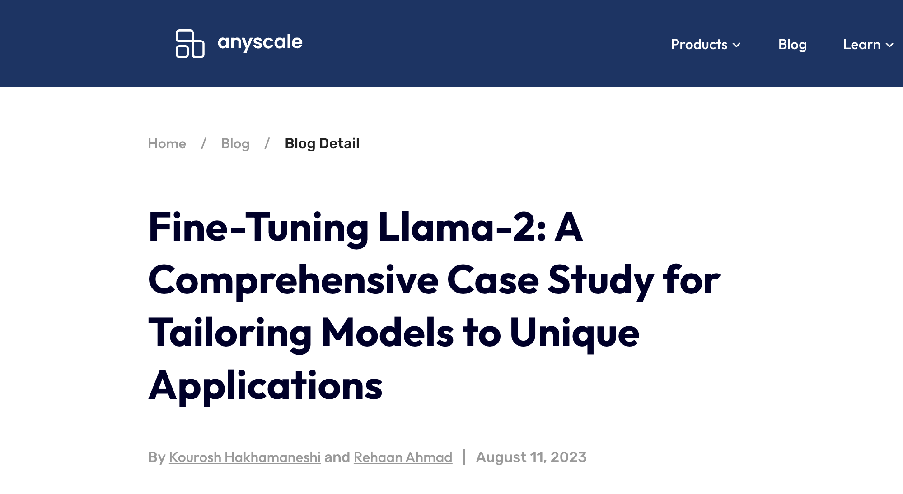
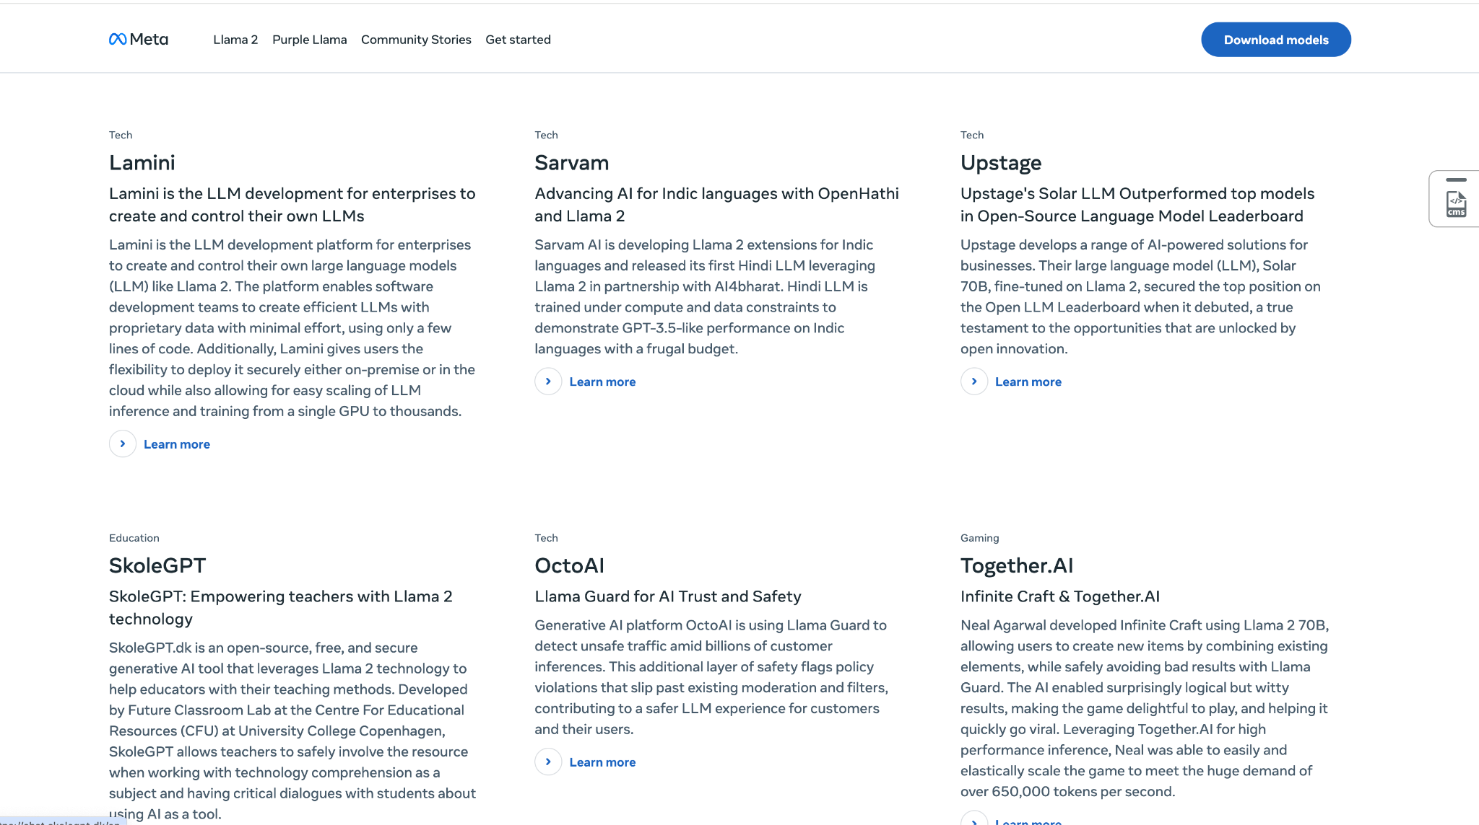
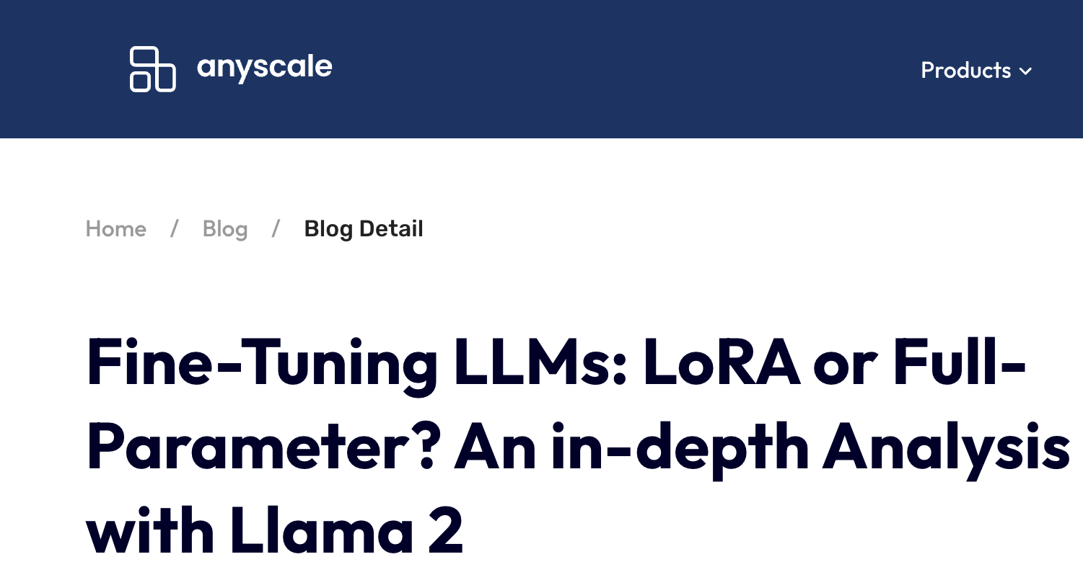
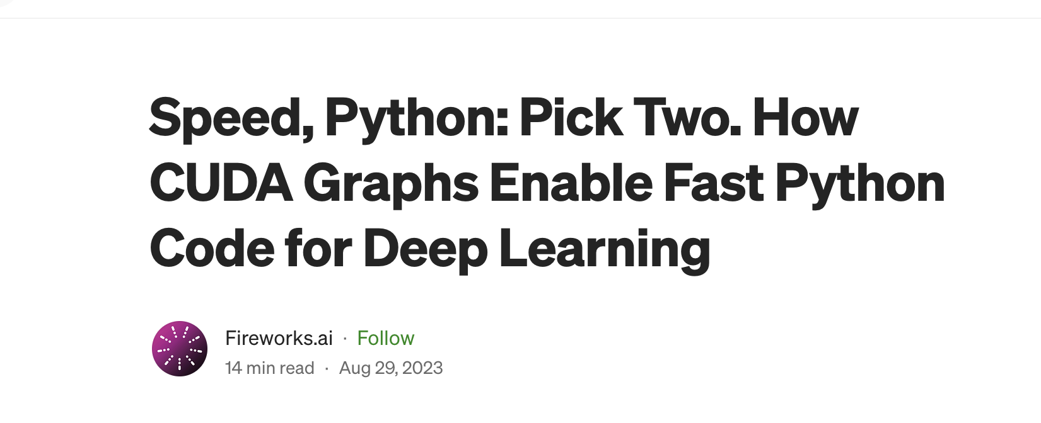
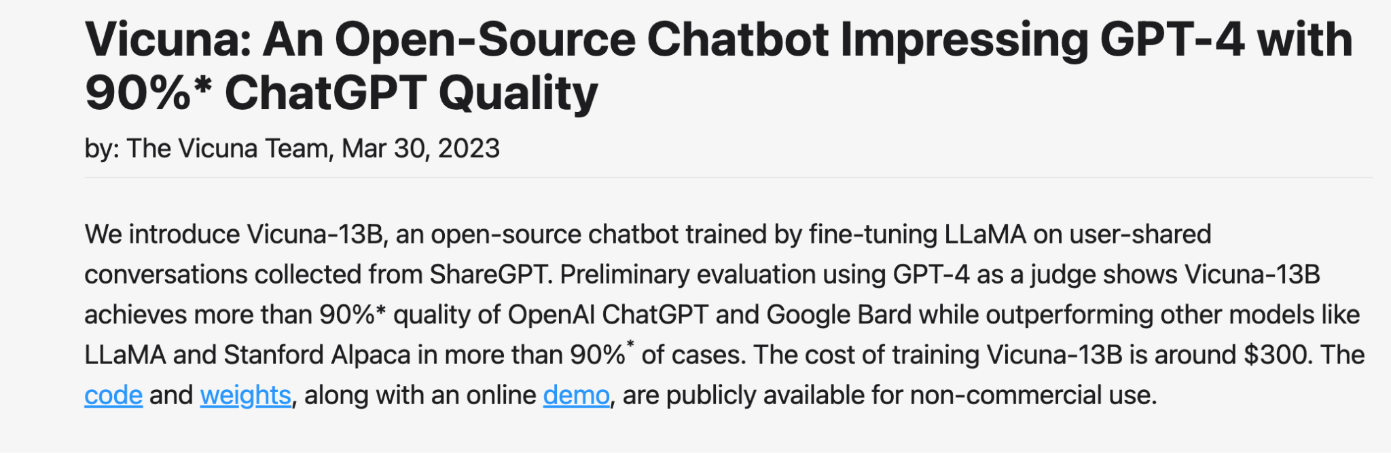
Community Stories

